Slide 1
Object Oriented Programming (OOP) Concepts In Java
WEEK 2

Slide 2
Lesson: Object Oriented Programming Concepts
https://docs.oracle.com/javase/tutorial/java/concepts/
This link provides a detailed explanation of the concepts of OOP
After this presentation, please go into this website and have a look for yourself

Slide 3
What is OOP?
Object-Oriented Programming is a methodology or paradigm to design a program using classes and objects. It simplifies the software development and maintenance by providing some concepts:
Object
Class
Inheritance
Polymorphism
Abstraction
Encapsulation

Slide 4
What is an object?
Any entity that has state and behavior is known as an object. For example: chair, pen, table, keyboard, bike etc. It can be physical and logical.
Software objects are often used to model the real-world objects that you find in everyday life.

Slide 5
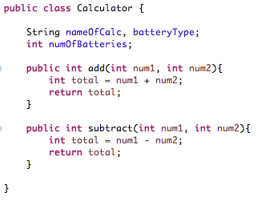
What is a class?
A class is a blueprint or prototype from which objects are created.

Slide 6
What is Inheritance?
Inheritance provides a powerful and natural mechanism for organizing and structuring your software.
Inheritance can be defined as the process where one class acquires the properties (methods and fields) of another. With the use of inheritance the information is made manageable in a hierarchical order.
The ability to create classes that share the attributes and methods of existing classes, but with more specific features
Inheritance is mainly used for code reusability. So you are making use of already written classes and further extending on that.
The class which inherits the properties of other is known as subclass (derived class, child class) and the class whose properties are inherited is known as superclass (base class, parent class).
extends is the keyword used to inherit the properties of a class.

Slide 7
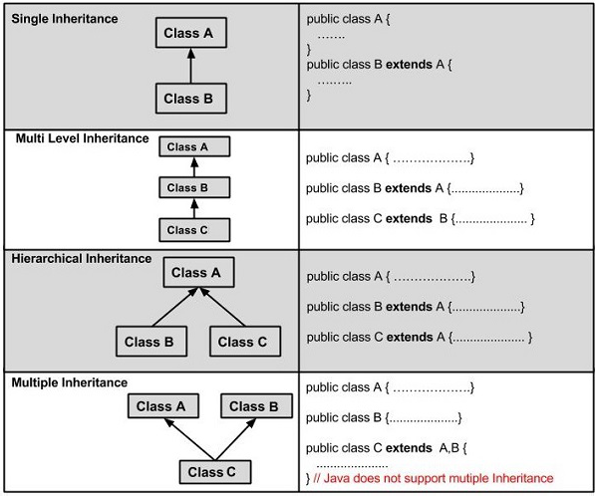
TYPES OF INHERITANCE

Slide 8
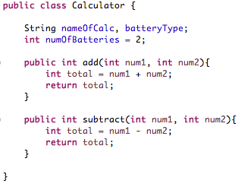
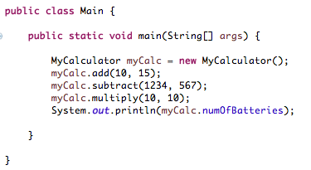
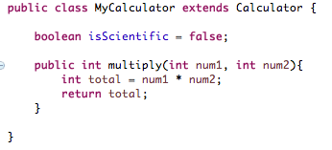
MAIN CLASS:
Created an instance of MyCalculator and was able to access Calculator class’s methods and variables because of inheritance.
Calculator class with variables & methods
MyCalculator class with a variable and method
Questions:
1. Which of the classes is the subclass? Which one is superclass?
2. What kind of inheritance is this?
3. All java classes derive from what class?

Slide 9
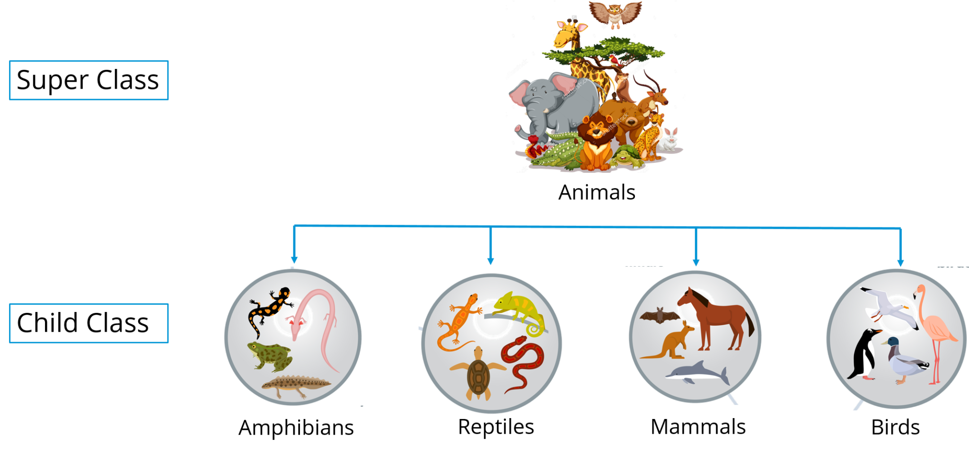

Slide 10
What is Polymorphism?
In Greek language, poly means many and morphism means shapes, hence Polymorphism in Java is the ability of an object to take on many forms.
It describes the feature of languages that allows the same word or symbol to be interpreted correctly in different situations based on the context.
For example, in English, the verb “run” means different things if you use it with “a footrace,” a “business,” or “a computer.” You understand the meaning of “run” based on the other words used with it. Object-oriented programs are written so that the methods having the same name works differently in different context.
Java provides two ways to implement polymorphism.
Method Overloading
Method Overriding

Slide 11
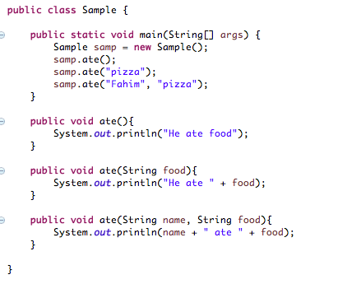
POLYMORPHISM: Method Overloading
The ability to execute different method implementations by altering the argument used with the method name is known as method overloading.
In the Sample program, we have three ate methods each with different arguments.
When you properly overload a method, you can call it providing different argument lists, and the appropriate version of the method executes.

Slide 12
POLYMORPHISM: Method Overriding
When you create a subclass by extending an existing class, the new subclass contains data and methods that were defined in the original superclass.
In other words, any child class object has all the attributes of its parent.
Sometimes, however, the superclass data fields and methods are not entirely appropriate for the subclass objects; in these cases, you want to override the parent class members.

Slide 13
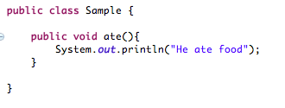
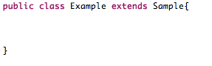
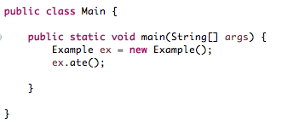
We have a class called Sample. Inside this class, we have a method called ate that prints out ”He ate food” to the console.
We have a class called Example that extends from class Sample. There are no variables or methods declared in Example class.
We create an instance of class Example and call on the ate() method.
What will it print out? It will print out : He ate food
What if we create a method called ate() inside Example class?

Slide 14
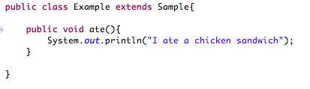
We have a class called Sample. Inside this class, we have a method called ate that prints out ”He ate food” to the console.
We have a class called Example that extends from class Sample. Inside this class, we have a method called ate that prints out “I ate a chicken sandwich” to the console.
We create an instance of class Example and call on the ate() method.
What will it print out? It will print out : I ate a chicken sandwich

